Slide 1
INTERACTIVE MEDICAL IMAGE SEGMENTATION USING DEEP LEARNING WITH IMAGE-SPECIFIC FINE TUNING
Reshma Reghunath
Class no:50 s7 Btech CSE
6 NOVEMBER,2018

Slide 2
INTERACTIVE MEDICAL IMAGE SEGMENTATION USING DEEP LEARNING WITH IMAGE-SPECIFIC FINE TUNING
CONTENTS
INTRODUCTION
METHOD
CNN MODEL
TRAINING OF CNN
SUPERVISED AND UNSUPERVISED FINE TUNING
WEIGHT LOSS FUNCTION
EXPERIMENTS AND RESULTS
CONCLUSION
REFERENCES

Slide 3
INTRODUCTION
INTERACTIVE MEDICAL IMAGE SEGMENTATION USING DEEP LEARNING WITH IMAGE-SPECIFIC FINE TUNING
Challenges of medical images
Interactive segmentation method
Challenges of using CNNs for interactive
segmentation

Slide 4
INTRODUCTION(Con.)
INTERACIVE MEDICAL IMAGE SEGMENTATION USING DEEP LEARNING WITH IMAGE-SPECIFIC FINE TUNING
Framework to address these challenges
Bounding-box-segmentation
Image specific fine tuning
Inference time and memory
efficiency

Slide 5
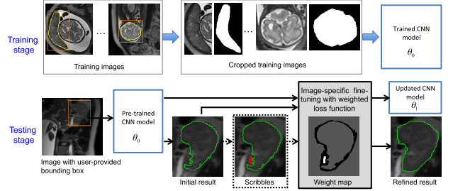
METHOD
INTERACIVE MEDICAL IMAGE SEGMENTATION USING DEEP LEARNING WITH IMAGE-SPECIFIC FINE TUNING
Bounding box and Image-specific Fine-tuning-based Segmentation (BIFSeg)

Slide 6
METHOD(Cont.)
INTERACIVE MEDICAL IMAGE SEGMENTATION USING DEEP LEARNING WITH IMAGE-SPECIFIC FINE TUNING
Pre-trained CNN with a forward pass to obtain initial segmentation
In the testing stage, the user provides a bounding –box
CNNs are designed and trained to learn some common features

Slide 7
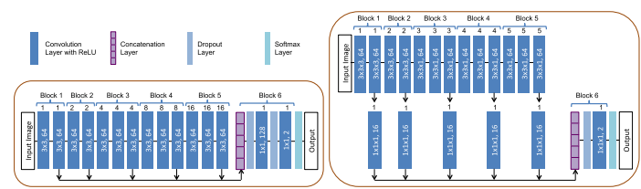
CNN-MODELS
INTERACIVE MEDICAL IMAGE SEGMENTATION USING DEEP LEARNING WITH IMAGE-SPECIFIC FINE TUNING
Resolution-preserving networks with dilated convolution for 2D and 3D segmentation

Slide 8
Method(Con.)
INTERACIVE MEDICAL IMAGE SEGMENTATION USING DEEP LEARNING WITH IMAGE-SPECIFIC FINE TUNING
Unsupervised (without additional user interactions) or supervised (with user-provided scribbles) fine tuning to further refine the segmentation
Fine tuning to leverage image-specific feature
Image-wise adaptation that can be guided by the user

Slide 9
CNN-MODELS (Cont.)
INTERACIVE MEDICAL IMAGE SEGMENTATION USING DEEP LEARNING WITH IMAGE-SPECIFIC FINE TUNING
P-Net for bounding box-based binary segmentation
Classifier and softmax layer in P-Net
3D network with feature compression as PC-Net.

Slide 10
Training of CNNs
INTERACIVE MEDICAL IMAGE SEGMENTATION USING DEEP LEARNING WITH IMAGE-SPECIFIC FINE TUNING
A K-ary segmentation training set
T = {(X1, Y1), (X2, Y2), . . .} where
Xp is one training image and
Yp is the corresponding label map
The label set of T is {0, 1, 2,..., K −1} with 0 being the background label

Slide 11
Training of CNNs(Cont.)
INTERACIVE MEDICAL IMAGE SEGMENTATION USING DEEP LEARNING WITH IMAGE-SPECIFIC FINE TUNING
N^=number of instances of the kth object
lpq=label of qth instance of Xp
Ypq=binary image of Yp
Bpq=bounding box

Slide 12
Training of CNNs(Cont.)
INTERACIVE MEDICAL IMAGE SEGMENTATION USING DEEP LEARNING WITH IMAGE-SPECIFIC FINE TUNING
X p and Ypq are cropped based on Bpq.
Cropped set Tˆ = {(Xˆ 1, Yˆ 1), (Xˆ 2, Yˆ 2), . . .}
with size Nˆ and label set {0, 1} where 1 is the
label of the instance foreground and 0 the background.

Slide 13

Training of CNNs(Cont.)
INTERACIVE MEDICAL IMAGE SEGMENTATION USING DEEP LEARNING WITH IMAGE-SPECIFIC FINE TUNING
Unsupervised and Supervised Image-Specific Fine-Tuning
P(yˆi|Xˆ ,θ) is the probability given by softmax output
pi = P(yˆi = 1|Xˆ ,θ) is the probability of pixel i belonging to the foreground

Slide 14


Weighted Loss Function
Weighted Loss Function During Network Update Step

Slide 15
EXPERIMENTS AND RESULTS
INTERACIVE MEDICAL IMAGE SEGMENTATION USING DEEP LEARNING WITH IMAGE-SPECIFIC FINE TUNING
2D Segmentation of Multiple Organs From Fetal MRI
Initial Segmentation Based on P-Net
Unsupervised Image-Specific Fine-Tuning

Slide 16
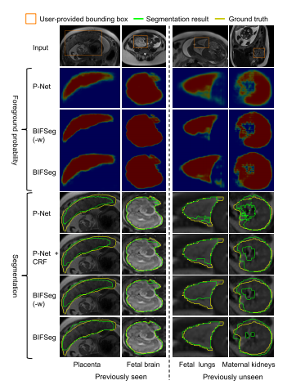
EXPERIMENTS AND RESULTS(Cont.)
INTERACIVE MEDICAL IMAGE SEGMENTATION USING DEEP LEARNING WITH IMAGE-SPECIFIC FINE TUNING

Slide 17
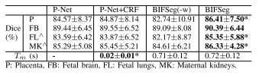
EXPERIMENTS AND RESULTS(Cont.)
INTERACIVE MEDICAL IMAGE SEGMENTATION USING DEEP LEARNING WITH IMAGE-SPECIFIC FINE TUNING
comparison of unsupervised and supervised fine-tuning of BIFSeg for the same maternal kidney
Comparison With Other Interactive Methods

Slide 18
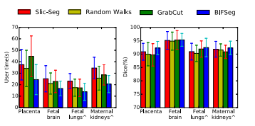
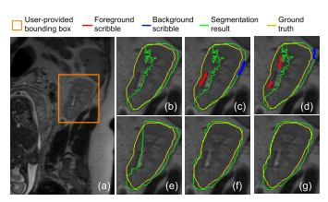
EXPERIMENTS AND RESULTS(Cont.)
INTERACIVE MEDICAL IMAGE SEGMENTATION USING DEEP LEARNING WITH IMAGE-SPECIFIC FINE TUNING

Slide 19
EXPERIMENTS AND RESULTS(Cont.)
3D Segmentation of Brain Tumors
Initial Segmentation Based on PC-Net
Unsupervised and supervised Image-Specific Fine-Tuning

Slide 20
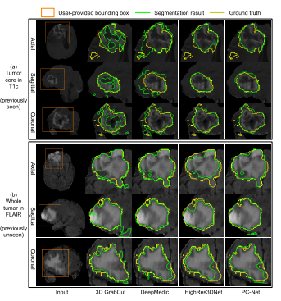
EXPERIMENTS AND RESULTS(Cont.)

Slide 21
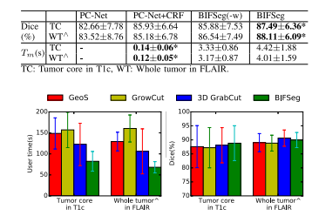
EXPERIMENTS AND RESULTS(Cont.)

Slide 22
CONCLUSION
Proposed framework accepts bounding boxes and optional scribbles as user interactions
Bounding boxes in test images are provided by the user, but they could potentially be obtained by automatic detection to further increase efficiency.

Slide 23
CONCLUSION(Con.)
Experimental results show that the image-specific fine-tuning improves the segmentation performance
BIFSeg allows optional supervised fine-tuning that leverages user interactions to achieve higher robustness and accuracy.

Slide 24
REFERENCES
G. Litjens et al., “A survey on deep learning in medical image analysis,” Med. Image Anal., vol. 42, pp. 60–88, Dec. 2017.
F. Zhao and X. Xie, “An overview of interactive medical image segmentation,” Ann. BMVA, vol. 2013, no. 7, pp. 1–22, 2013.
M. Rajchl et al., “DeepCut: Object segmentation from bounding box annotations using convolutional neural networks,” IEEE Trans. Med. Imag., vol. 36, no. 2, pp. 674–683, Feb. 2017.
N. Xu, B. Price, S. Cohen, J. Yang, and T. Huang, “Deep interactive object selection,” in Proc. CVPR, Jun. 2016, pp. 373–381.
G. Wang et al. (2017). “DeepIGeoS: A deep interactive geodesic framework for medical image segmentation.” [Online]. Available: https://arxiv.org/abs/1707.00652

Slide 25
REFERENCES
H. L. Ribeiro and A. Gonzaga, “Hand image segmentation in video sequence by GMM: A comparative analysis,” in Proc. SIBGRAPI, Oct. 2006, pp. 357–364.
K. Kamnitsas et al., “Efficient multi-scale 3D CNN with fully connected CRF for accurate brain lesion segmentation,” Med. Image Anal., vol. 36, pp. 61–78, Feb. 2017.
W. Li, G. Wang, L. Fidon, S. Ourselin, M. J. Cardoso, and T. Vercauteren, “On the compactness, efficiency, and representation of 3D convolutional networks: Brain parcellation as a pretext task,” in Proc. IPMI, 2017, pp. 348–360.
J. Long, E. Shelhamer, and T. Darrell, “Fully convolutional networks for semantic segmentation,” in Proc. CVPR, Jun. 2015, pp. 3431–3440.
L.-C. Chen, G. Papandreou, I. Kokkinos, K. Murphy, and A. L. Yuille, “DeepLab: Semantic image segmentation with deep convolutional nets, atrous convolution, and fully connected CRFs,” IEEE Trans. Pattern Anal. Mach. Intell., vol. 40, no. 4, pp. 834–848, Apr. 2018.

Slide 26
THANK YOU

